Slide 1

# The Inverted Pyramid: Mastering Communication Clarity IMG query="crystal clear pyramid refracting sunlight, modern professional feel, soft lighting" This presentation will show a powerful communication technique. It revolutionizes information delivery and is used in various fields. Learn to transform how you share critical information instantly. Prepare to master clarity!
by Bablu P
BP

Slide 2

What is the Inverted Pyramid?
The inverted pyramid is a storytelling method. It presents the most important information first. Key details are placed at the top, followed by supporting details. Prioritize your core message with this visual demonstration. Spot the difference in communication styles!

Slide 3


Slide 4
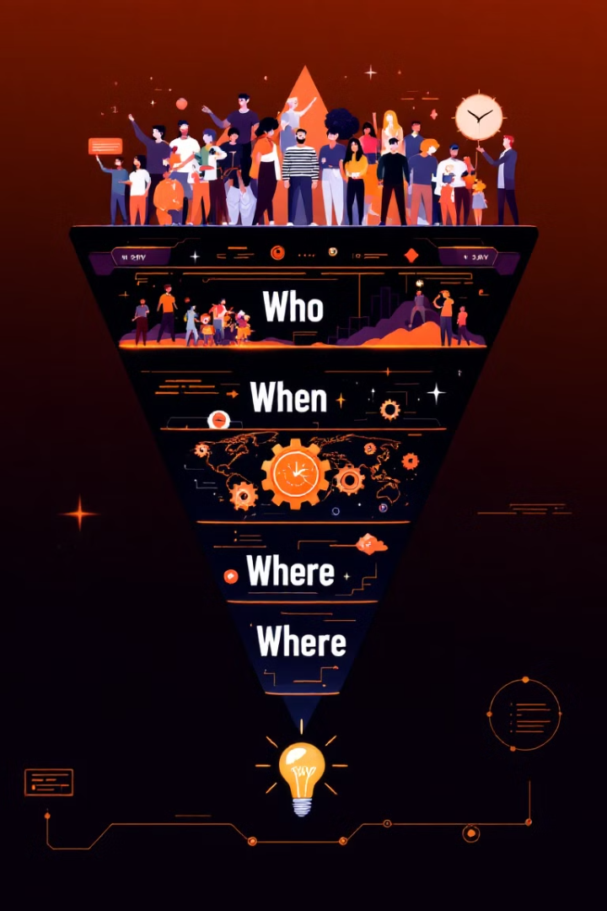
Key Components of the Inverted Pyramid
The most critical information goes in the opening paragraph. Who, What, When, Where, Why should all be at the beginning. Supporting details and context follow in decreasing importance. Keep it concise and to the point.

Slide 5


Slide 6

Practical Applications
Use it for business reports and presentations. It's also great for email communication and customer service scripts. Don't forget emergency communication protocols. Let's rewrite a paragraph using this technique!

Slide 7

Common Mistakes to Avoid
Avoid burying key information. Don't over-complicate your messages. Make sure you prioritize the core content. Identify your own communication challenges to improve quickly.

Slide 8


